Slide 1
R&D and applications of emulsion detectors in Switzerland
Tomoko Ariga
on behalf of the Bern emulsion group

Slide 2
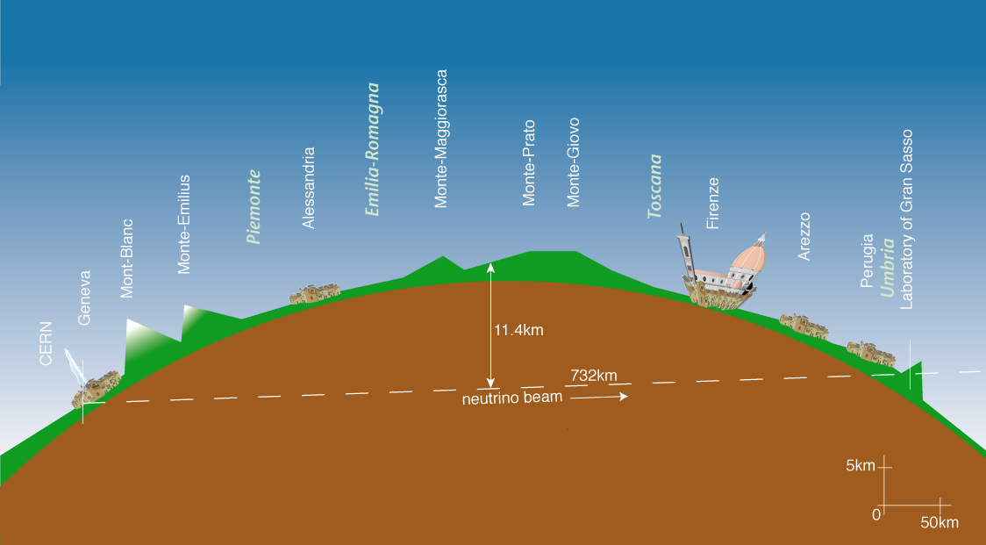
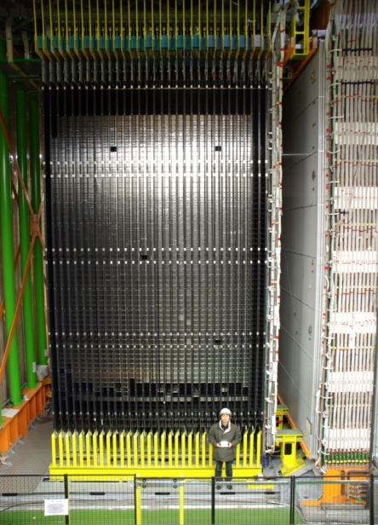
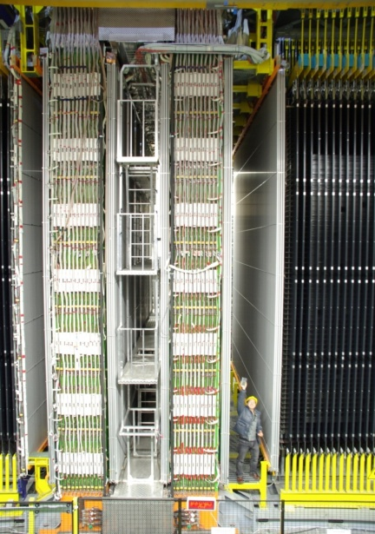
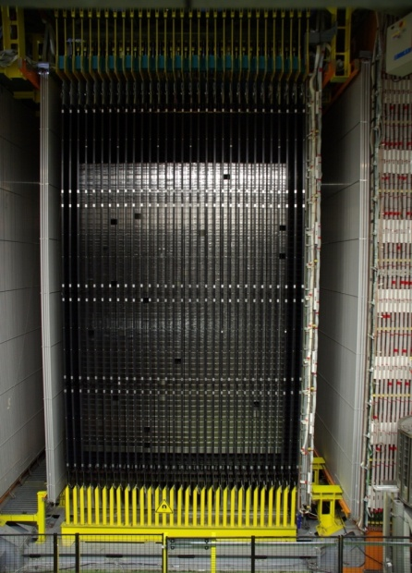
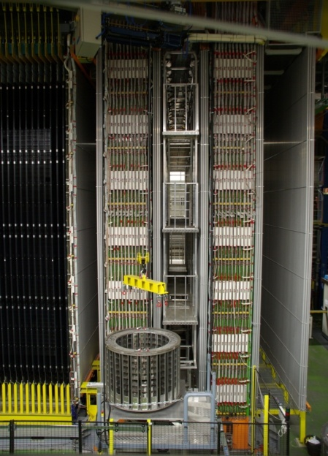
Swiss emulsion activity
Large contribution in the OPERA experiment
OPERA : Biggest-ever enterprise in emulsion experiment
Exploiting the know-how for the next experiments
R&D on emulsion technology
Physics applications
Direct detection of neutrino oscillations in appearance mode
More details in the OPERA talk by J. Kawada
CERN to Gran Sasso (CNGS) neutrino beam
OPERA detector 150,000 ECC 1.25kton target
about 9,000,000 emulsion films
~= 110,000 m²
CERN
L = 730 km
LNGS
2

Slide 3
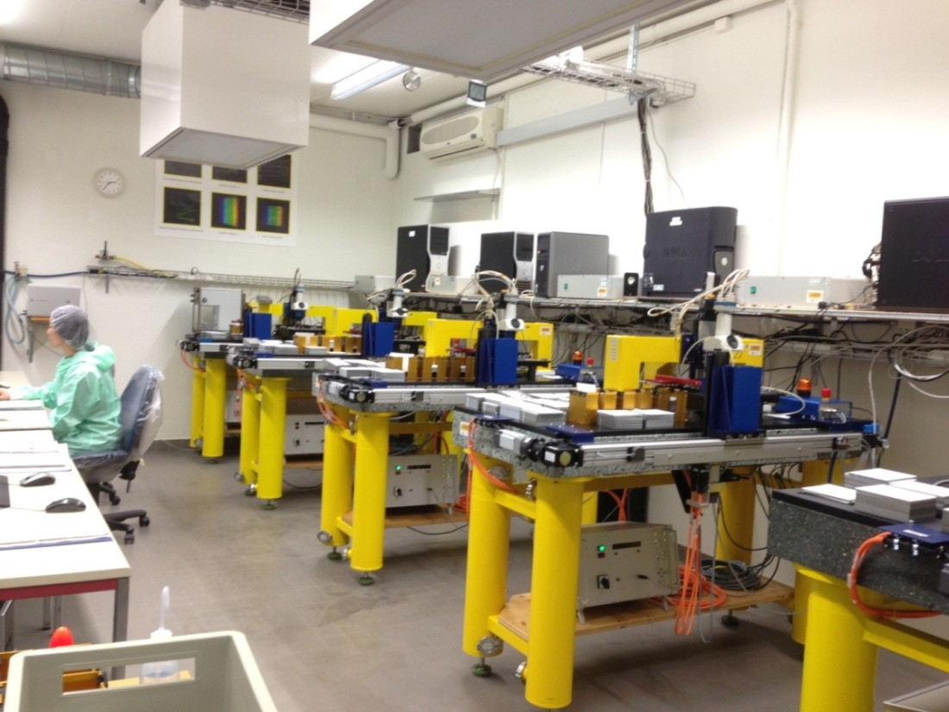
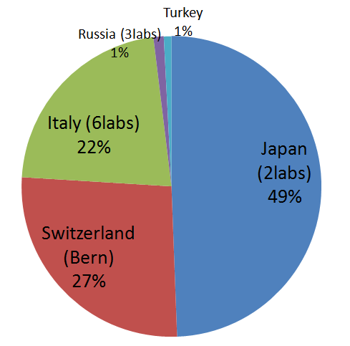
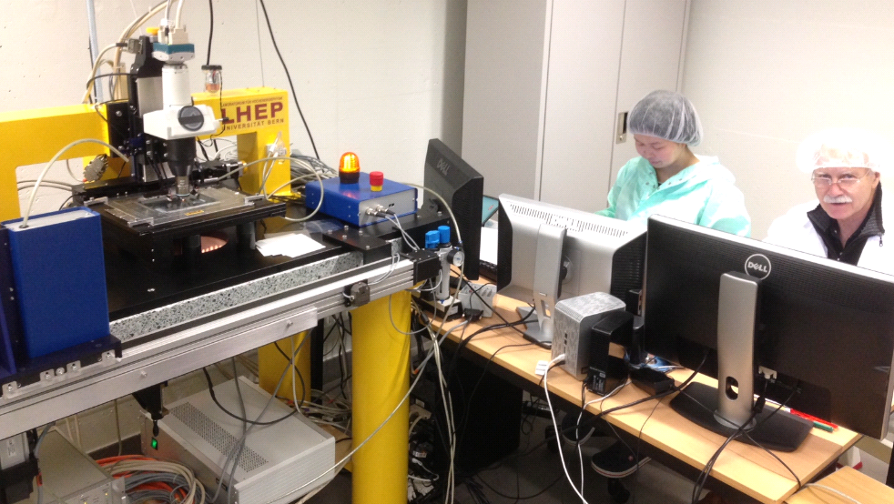
Swiss scanning station
Clean room
6 microscopes with automatic plate changer
Scanning and tracking speed
5microscopes for OPERA: 20cm²/h/mic
6th microscope: see the talk by A. Ariga
Several hundreds of emulsion sheets analyzed every week
6th microscope for R&D
Scanning share 2012-2013
First in Europe
Second OPERA emulsion scanning laboratory in the world

Slide 4
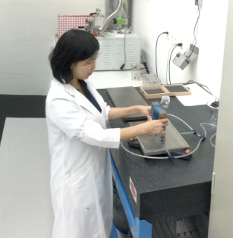
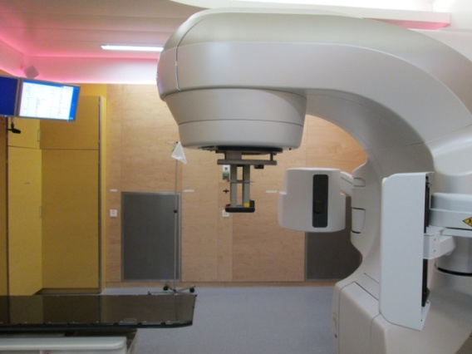
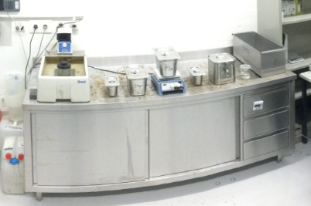
All infrastructures for R&D available in Bern Strong advantage of our group
Underground lab, 30 m deep
Film production
Performance check
Development
Scanning
22MeV electron
22MeV electron and 18MeV proton in Inselspital (hospital in Bern)
2.5MeV neutron from D-D fusion
OR
CERN and PSI

Slide 5
Underground emulsion facility
30m deep
Low cosmic-ray flux, suitable for emulsion film production
Pouring
Custom-made gel from Nagoya Univ. (Japan) and Slavich (Russia)
High precision pouring stages
Current maximum production rate:
3 x A4 size (double side coated)/day
Development
Capability of ~1 m²/day (~100 films)
Refurbished in 2013
Sub-dark room
Vacuum chambers
Development tanks and
temperature-controlled bath
Pouring tables
Equipments for cryogenic tests

Slide 6
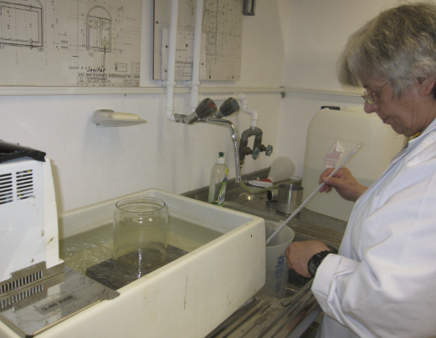
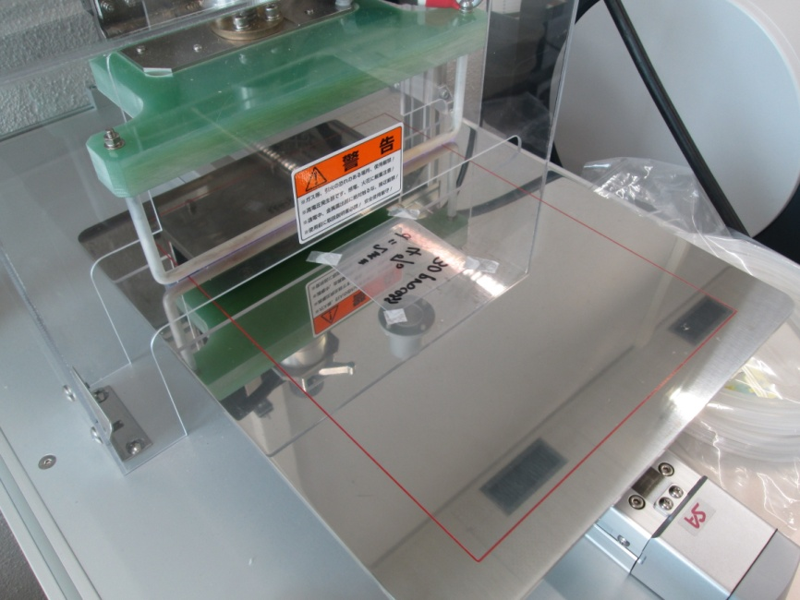
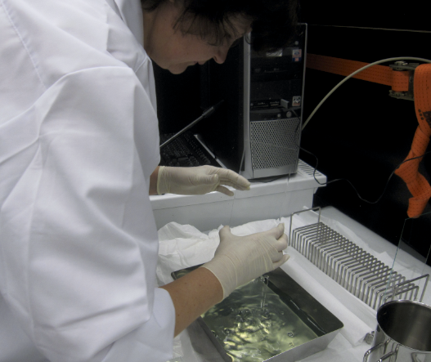
Studies on base treatment
For acrylic base
Chemical treatment (commercial plastic primer)
Works but not very strong
Corona discharge
Study is ongoing
For glass base
Chemical treatment (Dubna recipe)
Development in the framework of the INET Project (Switzerland Russia)
Corona discharge machine
Plastic film
Electrode
Stage

Slide 7
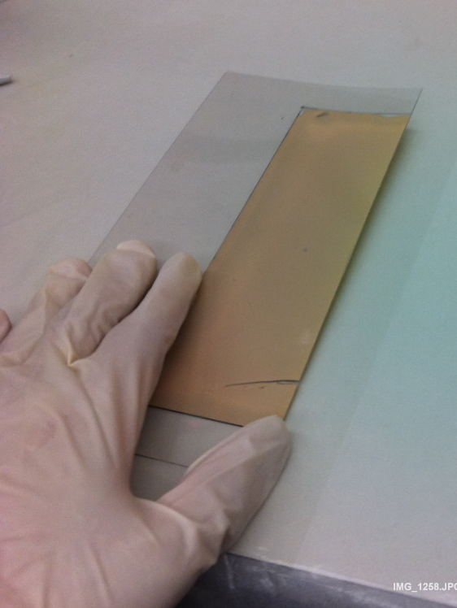
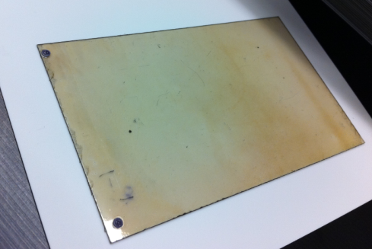
Emulsion film production (pouring)
Gel from Nagoya Univ. (Japan) and Slavich (Russia)
Multi-layer structure
Cross-section of basic type emulsion film
Protection layer (~1micron)
A piece of produced film
Emulsion (50-150micron)
Primer (~1micron)
Plastic base (70-400microns)
Primer
Emulsion
Protection layer
A developed film

Slide 8
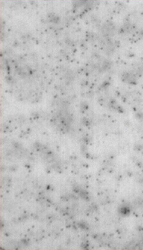
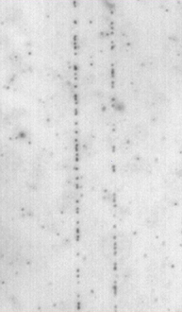
Sensitivity evaluation of produced films with CERN Test Beams in 2011
Reference (OPERA film)
Nagoya gel 2011
Slavich gel 15C 2011
100microns
Dev. 25min
GD 30.3
FD 10.1
Dev. 20min
GD 47.7
FD 1.9
Dev. 10min
GD 33.0
FD 5.4
 | Beam | Development time | GD (grains/100microns) | FD (grains/10microns cubic)
Reference (OPERA film) | CERN 10GeV pi- | 25 | 30.3 +- 1.6 | 10.1 +- 0.7
Nagoya gel | CERN 10GeV pi- | 20 | 47.7 +- 2.0 | 1.9 +- 0.2
Nagoya gel | CERN 10GeV pi- | 25 | 55.1 +- 2.6 | 3.0 +- 0.3
Slavich gel 15C | CERN 180 GeV pi/mu+ | 10 | 33.0 +- 1.0 | 5.4 +- 0.5

Slide 9
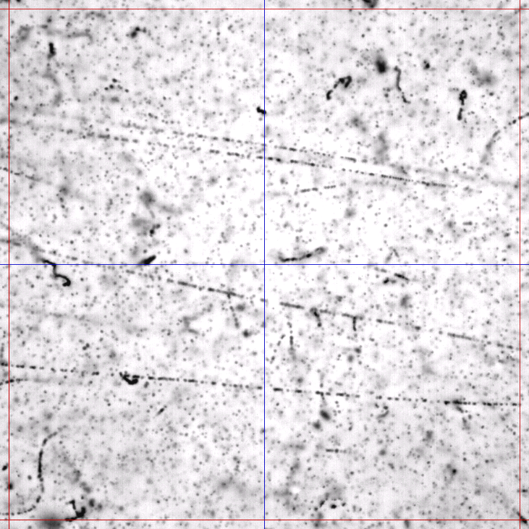
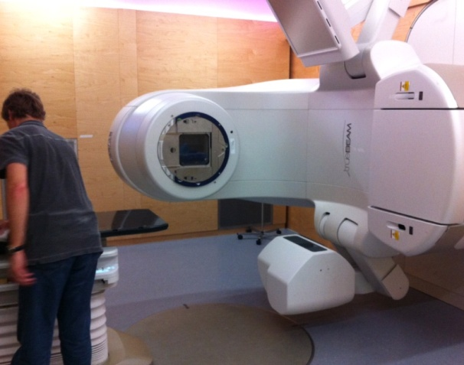
Irradiation with 22 MeV electrons from a linac of Clinic for Radiation Oncology (Inselspital)
22MeV electron
Sensitivity check
Gel type |  | Grain density (/100μm)
Nagoya A | AgBr30% | 39±3
Nagoya B | AgBr45% | 47±3
Nagoya C | AgBr55% | 59±4
OPERA film |  | 30±2
100μm

Slide 10
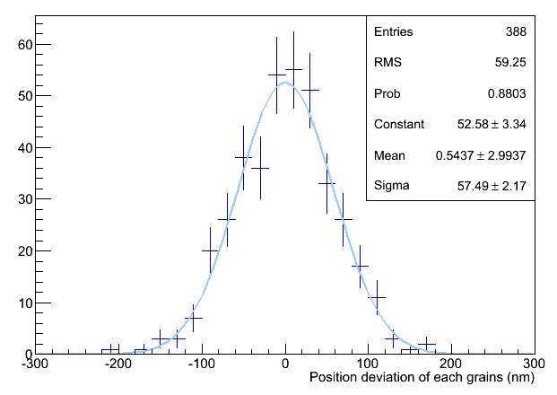
Intrinsic resolution of new film
Fit a line and evaluate deviation of each grains from the fitted line (line to point distance)
Find a straight tracks on the display
Measure the grains → Center of gravity calculation
(Use only grains near to the center of view ← to minimize optical distortion)
(Reject overlapping grains)
σ = 58 nm
JINST 8 (2013) P08013

Slide 11
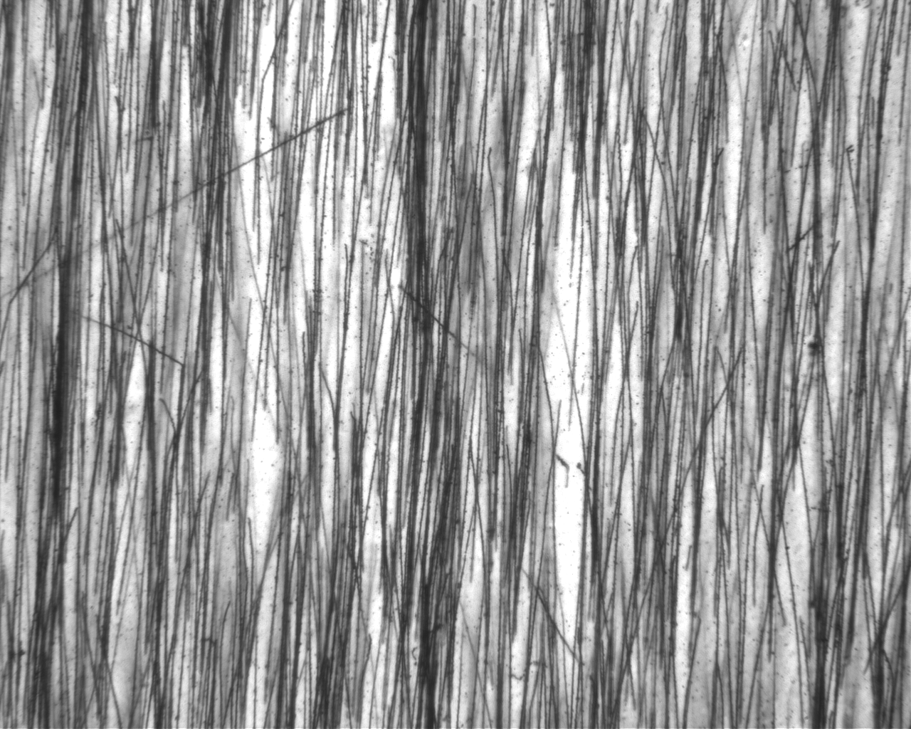
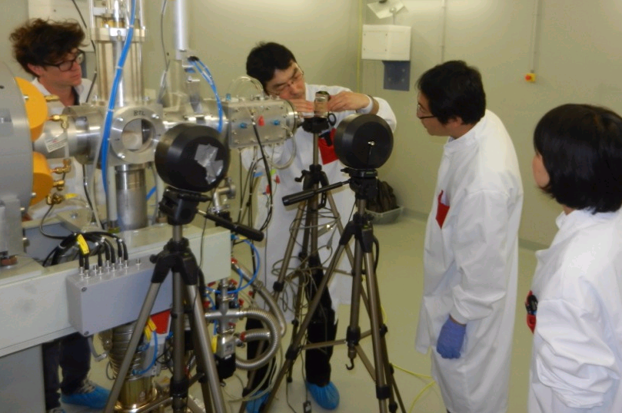
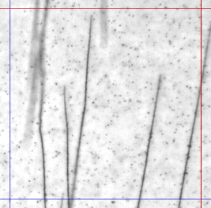
Irradiation with 18 MeV protons at the beam transfer line of the new Bern cyclotron laboratory (SWAN, Inselspital)
Emulsion distortion study
Particle identification by analyzing the stopping points
100 micron

Slide 12
Emulsion technology
Hardware
Scanning
Detector production
Microscope readout
Reconstruction
Development
Physics experiments
OPERA
AEgIS
Medical application
Neutron dosimetry
Proton radiography
Geosciences
Muon radiography
xxx
xxx
Accelerator
Beam monitoring
…
T2K
Beam characterization in proton therapy
Notes:
Application
Physics experiments
OPERA
AEgIS
Medical application
neutron dosimetry
proton radiography
Geosciences
muon radiography

Slide 13
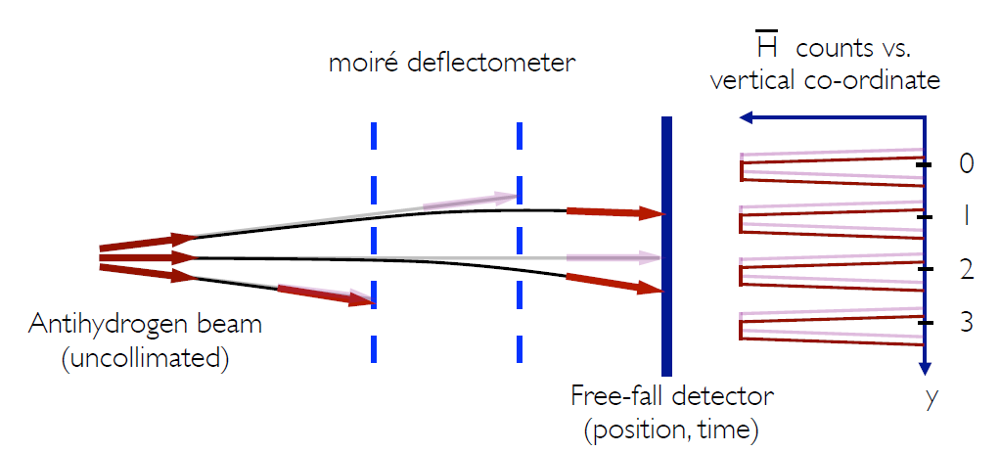
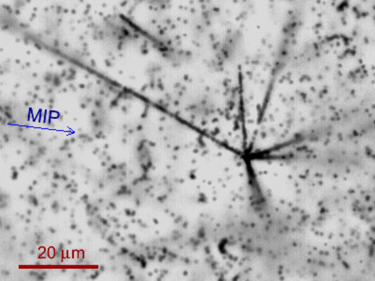
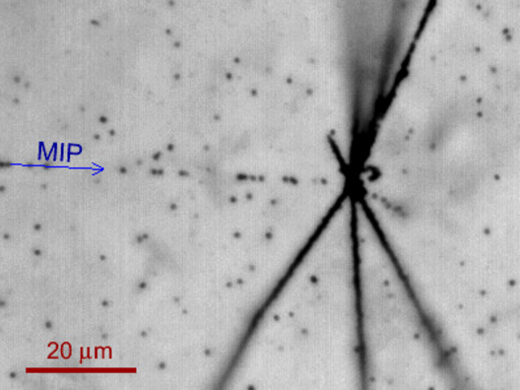
AEgIS experiment
See the talk by A.Ariga
Measurement of gravitational force on antimatter
→ Measurement of anti-H free fall (of the order of 10 microns)
Requirements for emulsion detectors… very challenging!
Absolute position resolution (1 micron) over 20cm x 20cm surface
Emulsion in vacuum
Sensitive at 77K
Emulsion detector
Test run in 2012
Annihilation vertex in OPERA film (left) and in new film with Nagoya gel (right)

Slide 14
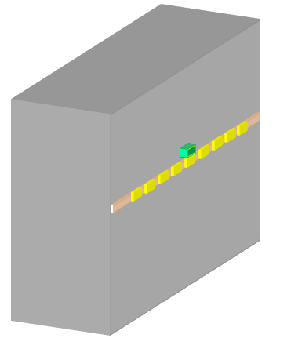
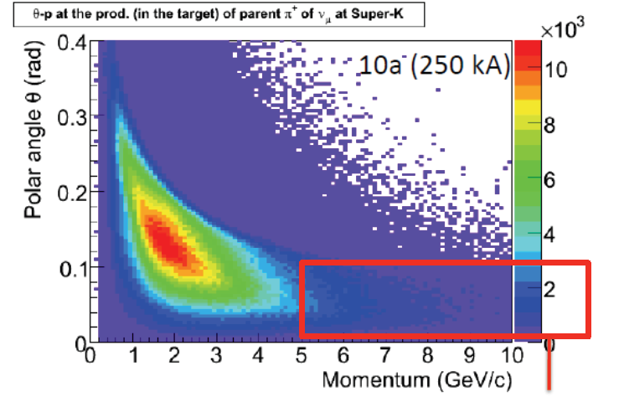
Absolute muon flux measurement at Muon pit in T2K experiment
Measure position, angle and momentum of muons
Absolute flux, angular and momentum distribution
Compare the distributions with beam MC with different hadron production models
Beam dump
Measurement
- Position
- 3D angle (Δθ=~3mrad)
- Momentum
π
μ
ν
~150X₀
energy loss 5GeV
MUMON
Emulsion tracker
P_{T}=30MeV/c
Decay volume
Transverse momentum
by scattering ~250MeV/c
Muon Pit
Phase space of pions whose daughters reach at SK
MUMON
Beam
Momentum module
Flux modules
Flux module : 8 films
Momentum module : 25 films interleaved by 1mm lead plates
MUMON/Emulsion cover this region

Slide 15
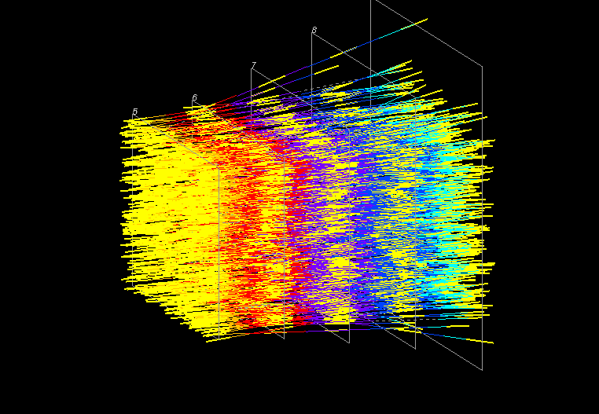
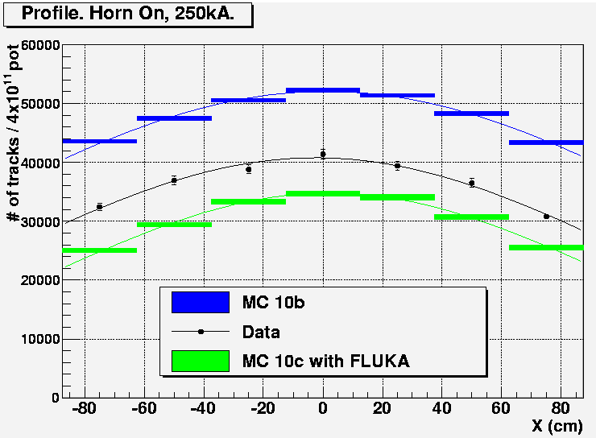
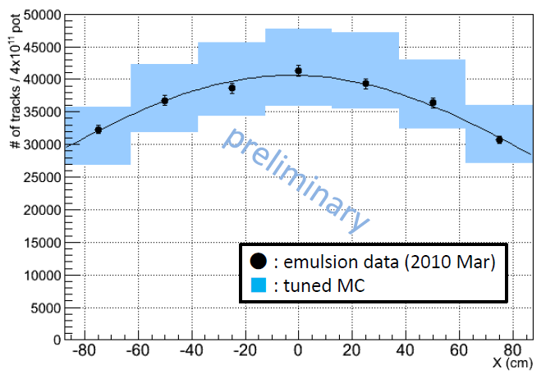
Comparison with MC
Reconstructed tracks
Absolute muon flux profile
2010
GCALOR
Data
Tracks reconstructed in 2mm x 2mm area (lead module).
Yellow line is emulsion film. The other colored line shows the extrapolation of measured tracks. The color by Z depth in the module.
FLUKA2008
Momentum distribution
2013
Updates in MC using NA61 results
Simulation in emulsion modules was done for MC samples.
Here we compare the reconstructed momentum for both MC and data.
GCALOR
Data
FLUKA2008

Slide 16
Medical application: neutron spectroscopy with emulsions
Secondary neutrons in clinical proton radiotherapy is a crucial issue for possible secondary cancer induction, causing an extra-dose to the whole body of the patient.
It is important to assess and minimize, the potential for second cancer induction by these secondary neutrons. (D.J. Brenner, E.J. Hall “Secondary neutrons in clinical proton radiotherapy: A charged issue” Radiot. and Oncol. 86 - 2008)
We are investigating the possibility of using the emulsion films to characterize the neutron fields
→ Neutron energy spectrum, Angular information
→ Neutron source imaging (reconstruction of neutron source)

Slide 17
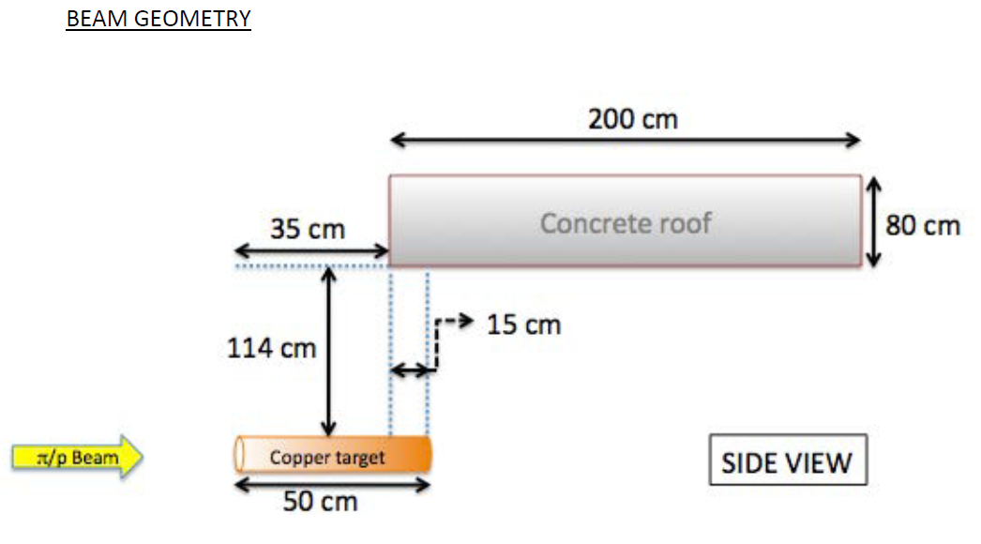
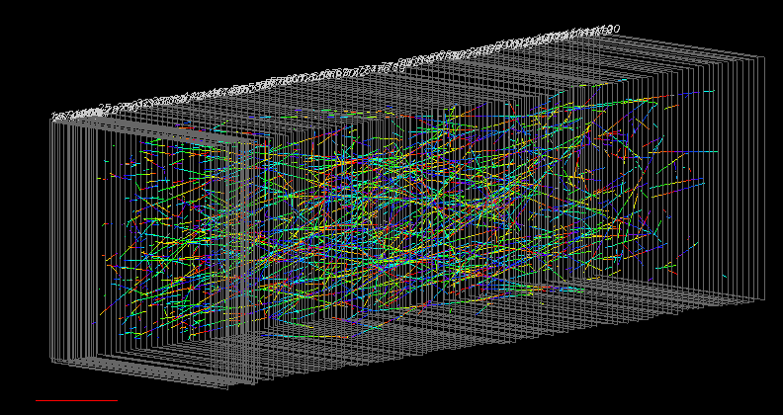
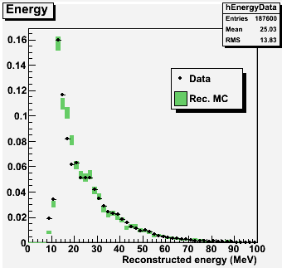
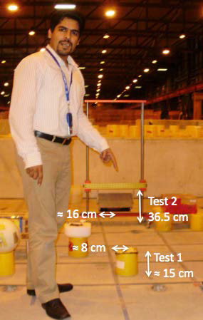
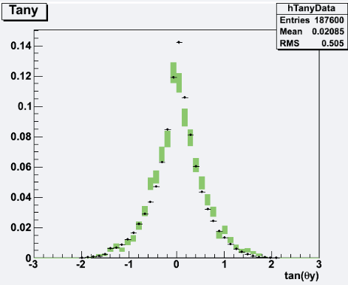
Neutron exposure at CERF facility, CERN
Some of selected tracks (1track/200tracks are shown)
1cm
Reconstructed proton energy
Angular distribution
Neutron spectrum unfolding
On going
Area normalized
Notes:
A charged hadron beam (protons, pions) with momenta of 120 GeV/c or 205 GeV/c (positive or negative) hit a copper target, 50 cm thick and 7 cm in diameter. The secondary particles produced in the interaction are filtered by a shielding of either 80 cm of concrete. Behind the concrete shielding, the neutron spectrum has a pronounced maximum at about 100 MeV.

Slide 18
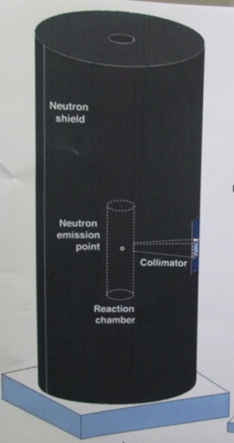
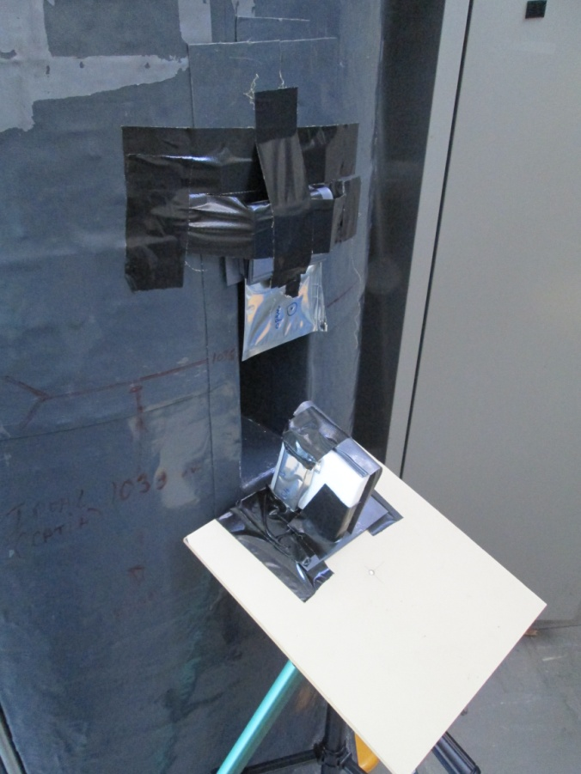
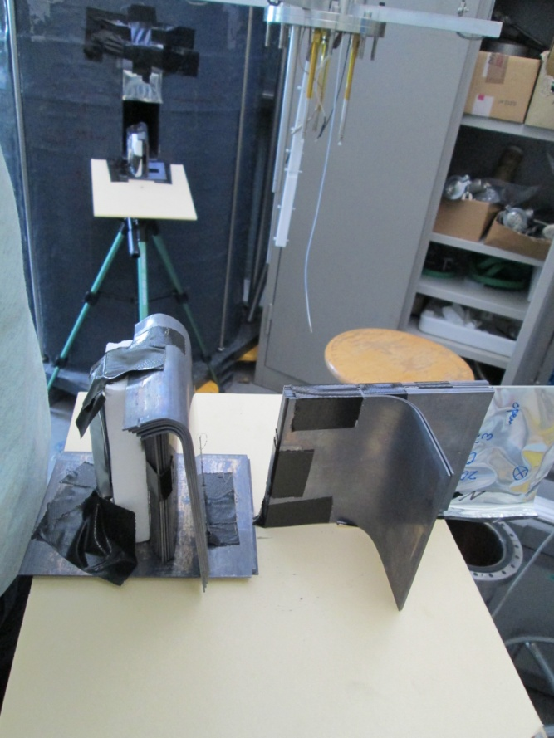
Proof of principle for neutron source imaging
2.5 MeV neutron from D-D fusion
→ recoil proton range is about 70 μm
45 cm
200 cm

Slide 19
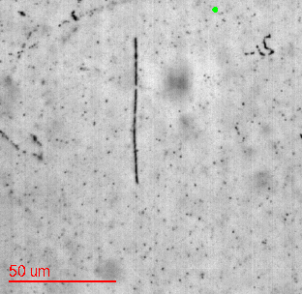
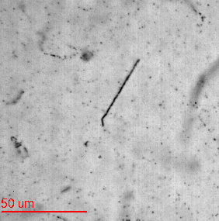
Monochromatic neutron beam (2.5 MeV neutron from D-D fusion)
Study of imaging of neutron source by using angular information of recoiled protons
neutron
neutron
Automatic tracking for short tracks is ready

Slide 20
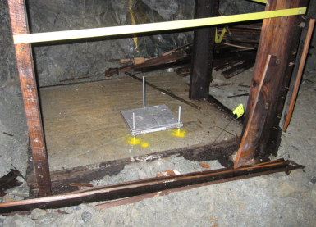
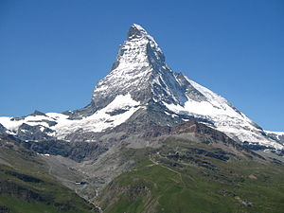
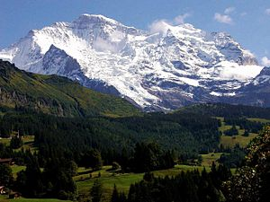
Other applications: muon radiography
Test in Vancouver
3D reconstruction of mineral deposit in Vancouver mine, Canada
→ Problem in uncertainty of efficiency
→ Need good quality films for next trials
Further plans for mountains in Switzerland
Water content in the mountain, in line of global warming
Set emulsion films in the mine

Slide 21
Summary
LHEP Bern is conducting an intensive R&D program on emulsion detectors for wide range of applications.
Infrastructures for R&D are available in Bern
Underground emulsion facility
Electron beam for sensitivity measurement
Scanning station, largest scale in Europe.
High sensitivity detector production has been established
Rich applications in many field
Physics: AEgIS, T2K
Medical: Beam monitoring, Neutron dosimetry
Geography: Mountain structure
etc.

Slide 22
Backup

Slide 23
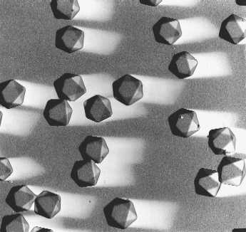
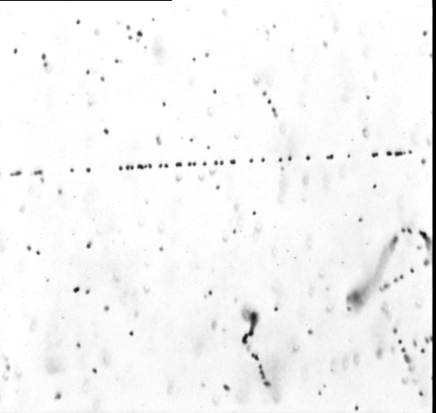
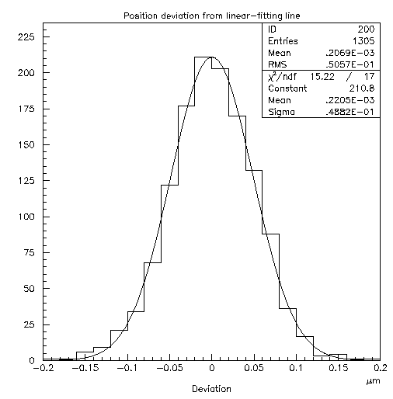
Nuclear emulsion detectors (ex. OPERA film by Fuji Film)
Emulsion Layer (44micron)
A minimal detector
AgBr Cristal,
Size = 0.2micron
Detection efficiency
= 0.16/crystal
10¹³ channels in a film
Plastic Base (200micron)
Emulsion Layer
Cross-sectional view (SEM)
Intrinsic resolution 50nm
Deviation from linear-fit line (2D)
sensitivity 36grains/100micron
π-10GeV/c
Electron ～100keV
20μm
23
Notes:
23

Slide 24
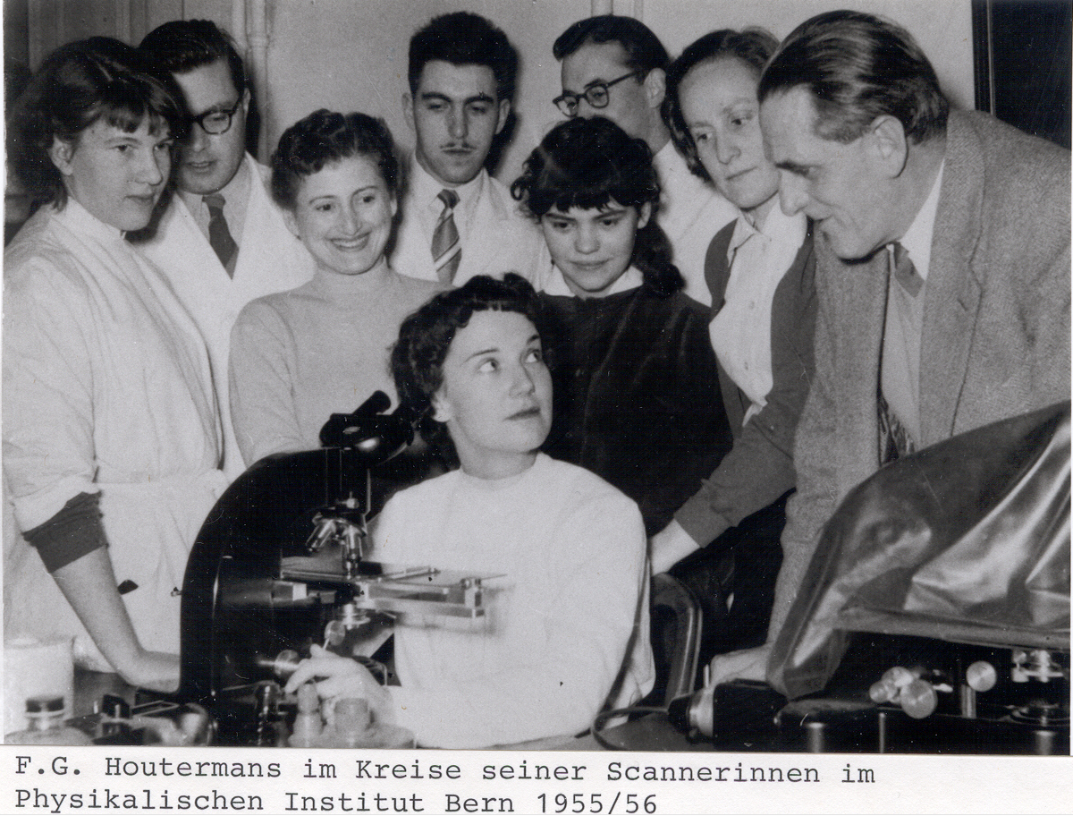
Emulsion in Bern, Long history…

Slide 25
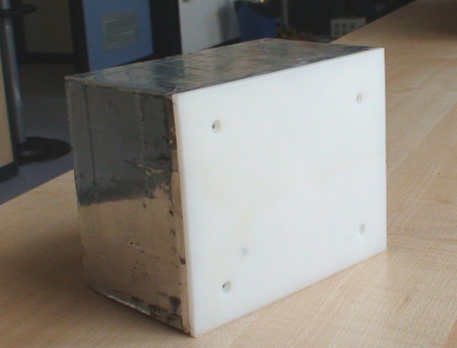
OPERA Experiment
Study neutrino oscillation though appearance of ν_{τ} in pure ν_{μ} beam
Basic unit : ECC Brick
57 emulsion films interleaved with 1mm read plates
CERN to Gran Sasso (CNGS) neutrino beam
neutrino
10.2 cm
7.5 cm
10 X0
12.5 cm
LNGS
CERN
L = 730 km
OPERA detector 150,000 ECC 1.25kton target
about 10,000,000 emulsion films ~= 110,000 m²
25
Notes:
25

Slide 26
OPERA Microscope in Bern
CMOS camera 1280×1024 pixel 256 gray levels 376 frames/sec (Mikrotron MC1310)
Emulsion film
Z stage (Micos) 0.05 μm nominal precision
Automatic Plate Changer
XY stage (Micos) 0.1 μm nominal precision
objective (Dry 50× NA 0.95)
20 min / cm²
Notes:
26

Slide 27
To reduce background from ⁴⁰K,
AgNO₃ aq
KBr+KI aq
NaBr+NaI
Gelatin
+Hot water
mix

Slide 28
Condensed, Na-type２ (dev 40min)
GD=93.9±4.5 FD=2.9±0.9
100μm

Slide 29
The SWAN Project in Bern
Initiated in 2007 by the Inselspital and the University of Bern
SWAN stands for SWiss hAdroNs
Aims:
Production of radiopharmaceuticals, for PET diagnostics in particular
Proton therapy
Multi-disciplinary research
Phases:
Cyclotron laboratory for radioisotope production and research
Proton therapy centre

Slide 30
The cyclotron and the Beam Transport Line (BTL)
IBA 18 MeV “twin” high current cyclotron (two H⁻ ion sources)
7 out ports (4 ¹⁸F liquid targets, 1 ¹⁵O gas target, 2 spare)
External beam line in a separate bunker: production and research in parallel

Slide 31
The Beam Transport Line (BTL)
Research and training activities: novel detectors, radiation biophysics, radioprotection, radiochemistry, radio-pharmacy, material sciences, …
Low currents (1 μA – 1 nA) and high currents (up to 150 μA)
Beam spots on target: from ≈ 5 mm to 20 mm diameter
BTL: 6 m long, 2 quadrupole doublets, neutron shutter

Slide 32
Optimized BTL
The optimization of the BTL has been successfully performed
Transmission of ≈97% at 150 μA stable for 60 minutes has been obtained
Transmission ≈99% at 10 μA and ≈100% at 1 μA

Slide 33
The new Bern cyclotron laboratory for PET radioisotope production and its beam line for multi-disciplinary research
The new cyclotron laboratory for radioisotope production and research in Bern has been constructed and successfully commissioned
Routine FDG production has started
A specifically conceived Beam Transfer Line (BTL) allows multi-disciplinary research in parallel with PET radioisotope production
Research activities with the BTL have started
Detector and accelerator physics
Non-intercepting beam monitoring systems
Radiation protection

Slide 34
Irradiation with 18 MeV protons at the beam transfer line of the new Bern cyclotron laboratory (SWAN, Inselspital)
Density
Center: too high (cannot measure)
2cm from center: 10⁵~10⁶ tracks/cm²
Proton
Horizontal exposure
Vertical exposure
p
100μm

Slide 35
Irradiation with 22 MeV electrons from a linac of the Clinic for Radiation Oncology (KRO) of the Inselspital
2nd exposure on Jul 15
Distance to
wall : 438 cm

Slide 36
Resolution before cuts
For the case of
Ti 5μm target, gap 250μm, 1mm glass base
Target:
Si 50μm or Ti 5μm
10000 antiproton
→ vertices with at least 2 tracks found for 6508 events
Smearing on Z: σ=3μm
2.3μm
rms 6.3μm
Eff 65%
Gap:
0, 100, 250, 500, 1000μm
(No insulator considered)
Glass base:
0.5, 1.0mm
Reconstructed vertex Y – true vertex Y

Slide 37
Resolution and efficiency
Selection: Δθ<0.1 & tanθ<3 & ΔZ<10+0.01xGap(μm)
0.5mm glass base
Gap (μm) | Si 50μm |  | Ti 5μm
 | σ (μm) | Eff | σ (μm) | Eff
0 | 0.9 | 0.47 | 0.7 | 0.39
100 | 1.3 | 0.46 | 1.1 | 0.40
250 | 1.8 | 0.44 | 1.7 | 0.38
500 | 2.8 | 0.41 | 2.5 | 0.35
1000 | 4.2 | 0.38 | 3.8 | 0.33
Gap (μm) | Si 50μm |  | Ti 5μm
 | σ (μm) | Eff | σ (μm) | Eff
0 | 0.9 | 0.39 | 0.7 | 0.34
100 | 1.3 | 0.38 | 1.0 | 0.33
250 | 1.8 | 0.38 | 1.4 | 0.32
500 | 2.2 | 0.35 | 2.1 | 0.31
1000 | 3.6 | 0.34 | 2.8 | 0.29
1mm glass base
Smaller gap is better → should be less than 250μm
No significant difference between Si 50μm and Ti 5μm
Multiplicity for Si is higher than Ti → efficiency for Si is higher
Notes:
Next:
Improvement of track selection (using angle difference between MTs)
Improvement on vertexing for >=3prong (searching best combination)

Slide 38
T2K
ND280
Goals
Discovery of ν_{e} appearance
Precise measurement of ν_{μ} disappearance
Long baseline neutrino oscillation experiment
Intense ν_{μ} beam from J-PARC to Super-K @295km
Near detector @280m (ND280)
Super-K
J-PARC
Kamioka
Tokai
ND280
J-PARC
(KEK-JAEA)
ν_{μ}
50 kton water Cherenkov detector
Japan
30 GeV proton beam, design power of 750 kW

Slide 39
Emulsion exposures
Horizontal aluminum support
1st emulsion exposure (run24, 27th May 2009)
7 flux modules for each shot.
Flux module : 5 films + 5 films interleaved by 0.5mm lead plates.
Horn off (0kA) and horn1 on (I₁ = 200kA, 250kA)
Emulsion modules
2nd emulsion exposure (run31, 18th Mar 2010)
9 flux modules + 1 momentum module for each shot.
Flux module : 8 films
Momentum module : 25 films interleaved by 1mm lead plates.
Horn off (0kA) and all horns on (I1 and I23 = 250kA)
Vertical support

Slide 40
Neutron spectrum outside the concrete side-shield

Slide 41
Muon radiography in Vancouver mine
Purpose
Set emulsion films in the mine
- 3D reconstruction of mineral deposit in Vancouver mine, Canada.
140 days exposure in the mine at 10 places.
→ Exposure was done,
Scanning & Analysis is now on going.
Emulsion
Lead plate (1mm)
scintillator
emulsion
Emulsion
Detector structure
Comparison with scintillator and emulsion result

